Slide 1
GIT Basics

Slide 2
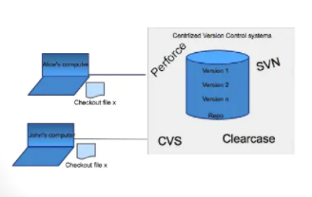
GIT Introduction
Free open source distributed system
Version Control System (VCS)
Two Types
Centralized VCS
Distributed VCS
Centralized VCS

Slide 3
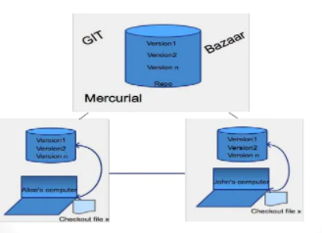
GIT Introduction Cont..
Distributed VCS

Slide 4
GIT Init
Git init
Git clone <url>
Git init vs. Git clone
Git add .
Git commit -am “Standard Name with version control”
Git push origin
Git pull origin

Slide 5
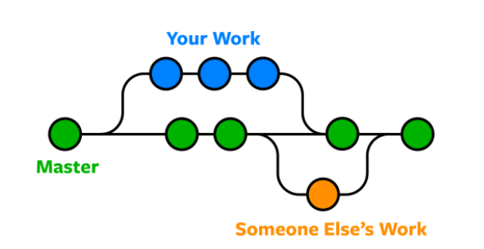
Git Branch
Listing current branches
git branch
Making a new branch
git branch <branch-name>
Switching to a branch
git checkout <branch-name>
Pushing the branch to Git
git push origin <branch-name>

Slide 6
Thank You

